Slide 1
CSS Extension for Round Displays @ Web Developers Meetup in Google Sydney
Jihye Hong
(jh.hong@lge.com)
Software Platform Lab., LG Electronics

Slide 2
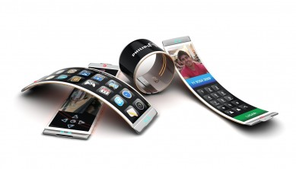
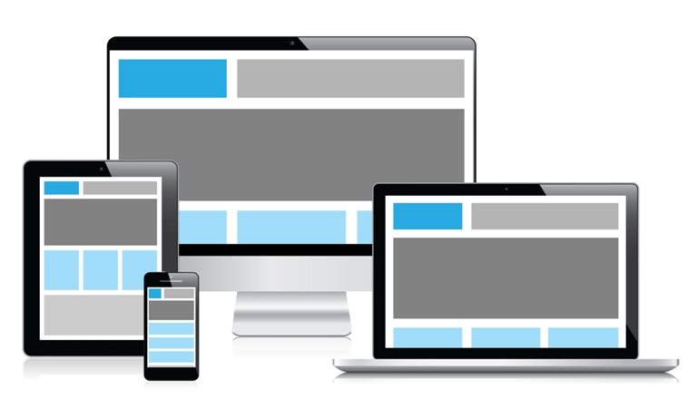
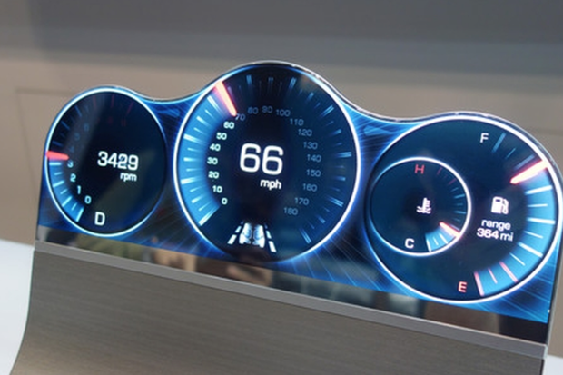
Background
Common web pages in the rectangular screens
Web Platforms in various shapes of display
Wearable, Flexible, Bended …

Slide 3
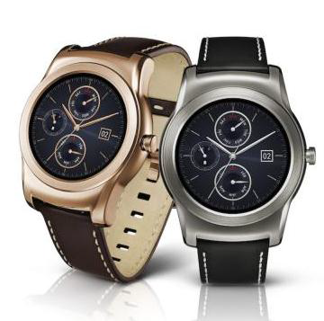
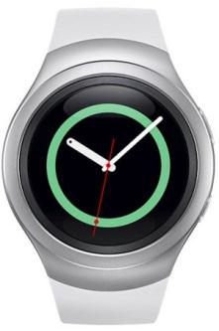
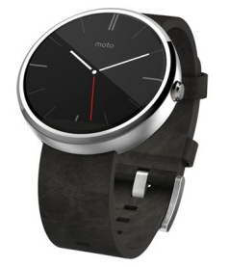
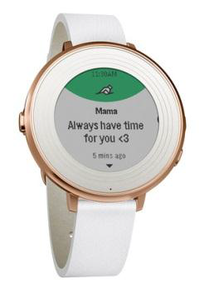
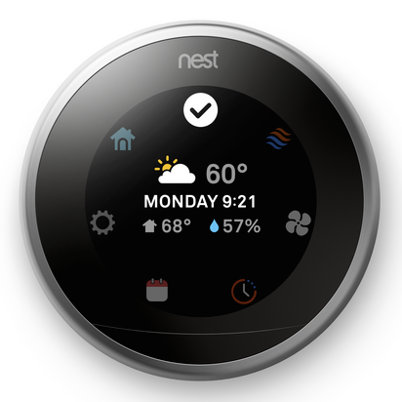
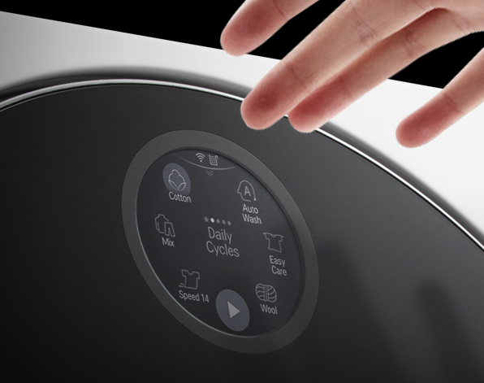
Background
Round display is natural for Smart watches
Round display provides better UX
What can CSS do for the Round display?
LG Watch Urbane LTE
Samsung Gear S2
Moto 360
Pebble Time Round
webOS Tizen Android Pebble SDK

Slide 4
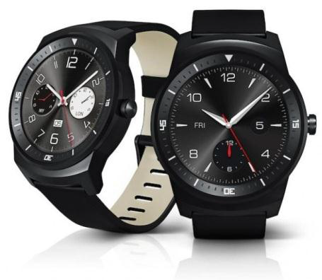

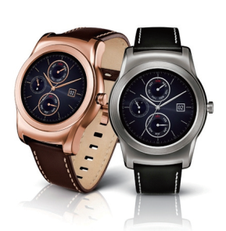
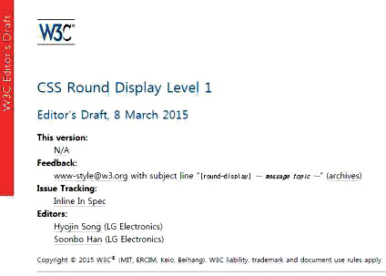
History
Sept, 2014
IFA 2014 ｜ Berlin
LG G Watch R at IFA 2014
Oct, 2014
TPAC 2014 Breakout Session ｜ Santa Clara
Introducing CSS Extensions for a Round Display
Feb, 2015
MWC 2015｜ Barcelona
LG Watch Urbane LTE
Feb, 2015
CSS WG F2F Meeting｜ Sydney
Editor’s Draft of CSS Round Display

Slide 5
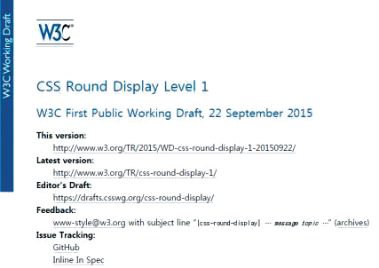


History
Aug, 2015
CSS WG F2F Meeting｜ Paris
First Public Working Draft of CSS Round Display
Oct, 2015
TPAC 2015 W3C Developer Meetup ｜ Sapporo
Introducing the last version of CSS Round Display

Slide 6
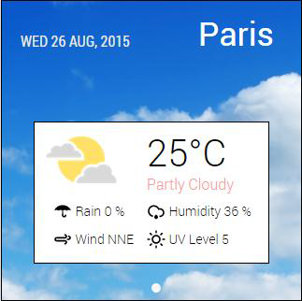
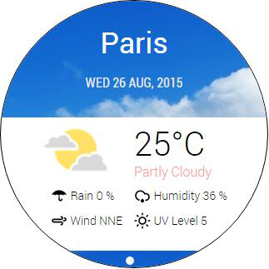
Detecting a round screen (Media Query)
device-radius
Inspired by border-radius
Coverage: Rectangle with rounded corners, Circle, Ellipse, Diamond, ...
[1]
[2]
[1]: <link media="screen and (device-radius: 0%)" rel="stylesheet" href="rectangle.css”/>
[2]: <link media="screen and (device-radius: 50%)" rel="stylesheet " href="round.css”/>
Notes:
Media Queries enables authors to apply different styles.
- Add a new media feature

Slide 7
Aligning content in the shape of display
Extend shape-inside
Add display as a new value
ABCDEF
GHIJKLM
NOPQRS TUVWXY
ABCD EFGHIJK LMNOPQ RSTUV
shape-inside: circle (50% at 50%, 50%);
shape-inside: display;
?
shape-inside: display;
ABCDEFGHIJ
ABCDEFG HIJ

Slide 8
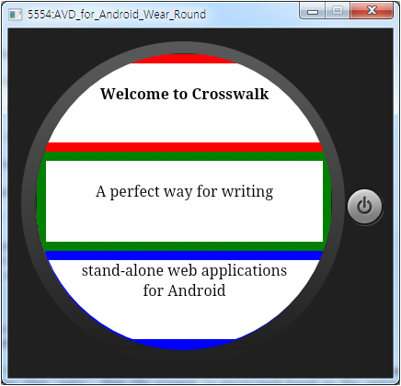
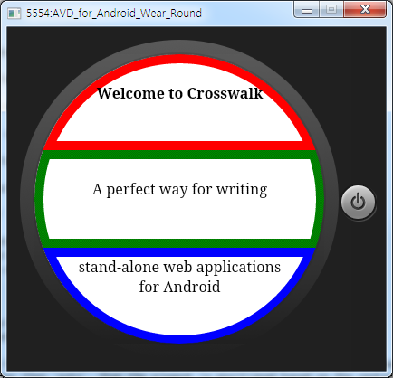
Drawing borders along the display edge
border-boundary
Value: none(default) | parent | display
border-boundary: none;
border-boundary: display;

Slide 9
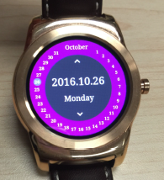
Polar Coordinates
polar-distance
Distance between the origin of polar coordinates and the anchor point of the element
Activates polar positioning with non-auto value
contain for avoiding overflow
polar-angle
Angle from the Y-axis
<div id=“container” >
<div id=“red” style=“position: absolute; polar-angle: 0deg; polar-distance: 50%”></div>
<div id=“green” style=“position: absolute; polar-angle: 90deg; polar-distance: 100%”></div>
<div id=“blue” style=“position: absolute; polar-angle: 225deg; polar-distance: 100% contain”></div>
</body>

Slide 10
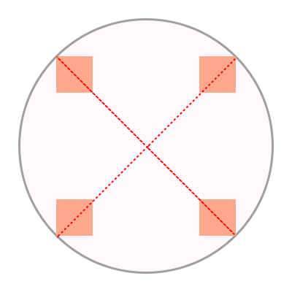
Origin Point and Anchor Point
polar-origin
Origin of polar coordinates
polar-anchor
A representative point of the element
<div id=“container” style=“position: absolute”>
<div id=“item1” style=“polar-angle: 45deg; polar-distance: 100%; polar-anchor: right top;”></div>
<div id=“item2” style=“polar-angle: 135deg; polar-distance: 100% polar-anchor: right bottom;”></div>
<div id=“item3” style=“polar-angle: 225deg; polar-distance: 100% polar-anchor: left bottom;”></div>
<div id=“item3” style=“polar-angle: 315deg; polar-distance: 100% polar-anchor: left top;”></div>
</body>

Slide 11
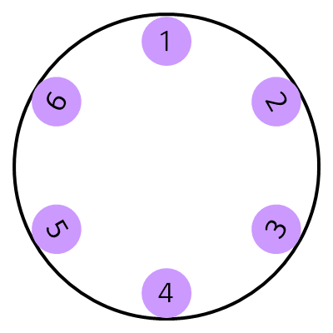
Rotating elements inward / outward
Extend rotate() function
Add polar-angle, polar-angle-reverse keyword values
rotate() = rotate( <angle> | polar-angle | polar-angle-reverse)
transform: rotate(polar-angle);
transform: rotate(polar-angle-reverse);

Slide 12
Several Issues of Polar Positioning
General uses of polar-origin and polar-anchor
polar-anchor vs. margin-left & margin-top
Margin for polar-anchor: center

Slide 13


Scrolling in Round Displays
Typical interaction on displays
Types of Scrolling
Issues for List Type
List type
Card type
This is some text I want to show you while scrolling .
This is some text I want to show you while scrolling .
Overflowing text
This is some text I w
Wasted spaces
Notes:
Typical interaction on displays
list item, long texts
List Type
The list type screen is well suited for a list of text-focused information. Each item in the list usually comes with subscreens. A list type screen can provide a good overview of the items on a page, and is suitable when quick navigation is required for multiple items. This type of navigation design is presented with a circular scroll bar to indicate which part of the content is currently viewed.
Card Type
The card type screen is ideal for providing information that can be presented on a single card. The card type screen does not allow continuous scrolling of the contents, but users can tap on the card to view the detailed information on a subscreen. As you navigate up or down the screen, the next card or the previous card snaps into the screen.

Slide 14
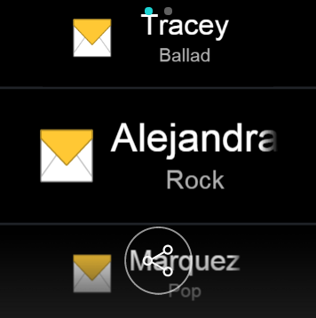
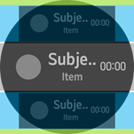
Specify the focused area with pseudo-class
Dynamic scaling and aligning
LG G Watch Urbane, Samsung Gear S2, …
Implemented by JS
Triggers layout of all the elements for each frame
poor performance and lead to skipped frames
Regional pseudo-class
:region( [ center || left || top || right || bottom ]? )
Select an element in a specific area
center: overlaps the center point of a containing block
top: touches the top edge of a containing block
left: touches the left edge of a containing block
bottom: touches the bottom edge of a containing block
right: touches the right edge of a containing block

Slide 15
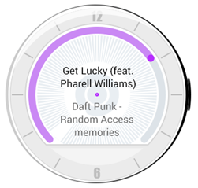

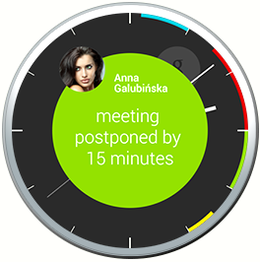
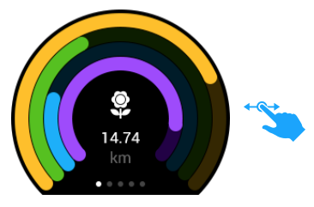
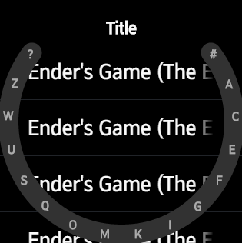
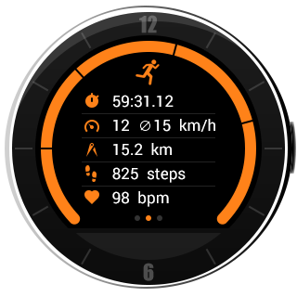
More Requirements for Round Displays
Drawing Arc
How can we draw the arc using CSS?
Animation, Smoothing the end of an arc, …

Slide 16
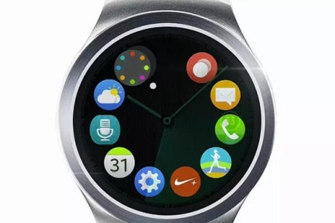
More Requirements for Round Displays
Flexbox Extension
Avoids elements overlapping and overflowing
[ Samsung Gear S2]
Notes:
http://www.pocket-lint.com/news/130896-the-apple-watch-looks-far-better-with-a-round-face-it-suits-the-ui

Slide 17
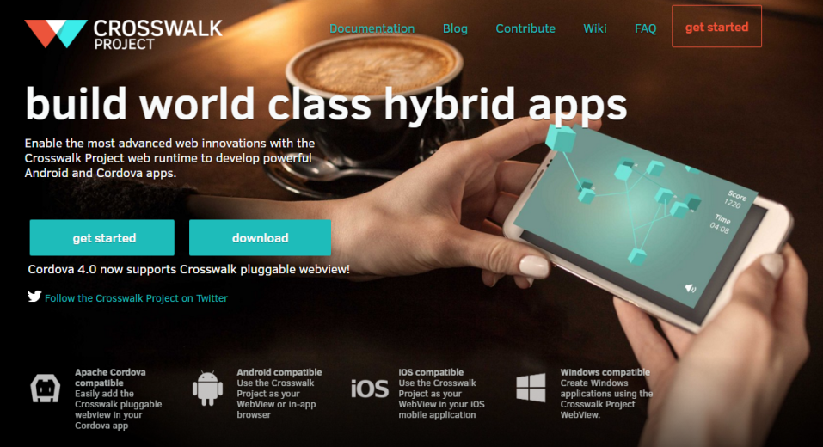
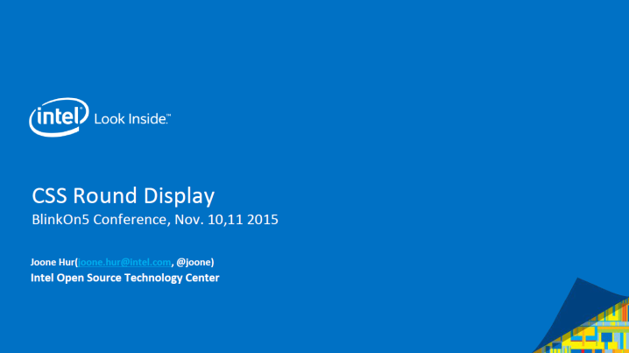
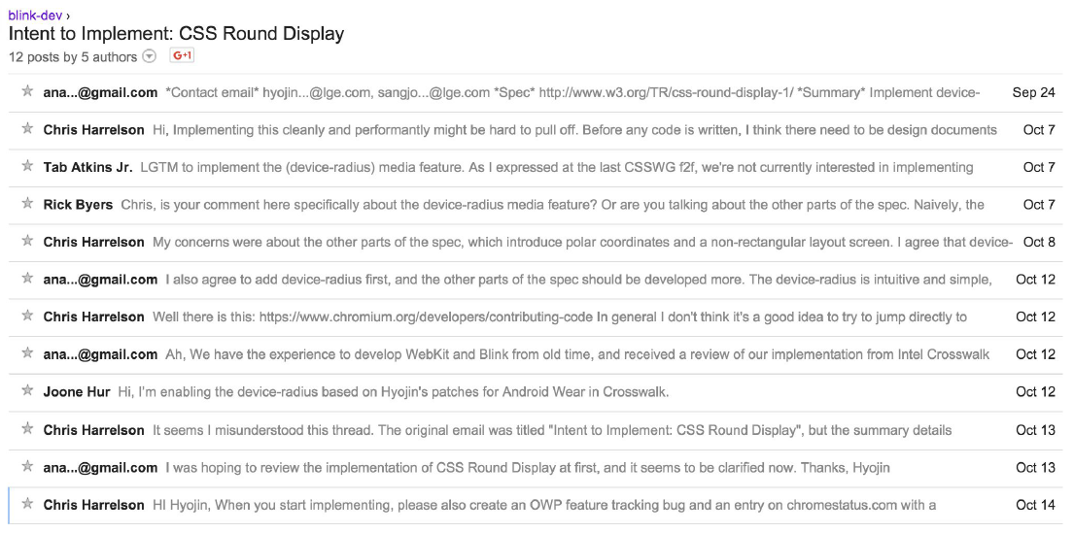
Collaboration with Intel
Crosswalk Project
Hybrid application
Incl. web runtime (blink)
Wearable as a target device
Blink Implementation
device-radius, border-boundary, polar positioning
BlinkOn5 presentation by Intel (Nov. 11, 2015)
Joint demo in CSS WG Meeting

Slide 18
Conclusion
New display shape(non-rectangular) will ever emerge
CSS Round Display
device-radius / shape-inside: display border-boundary: display / polar positioning
Scrolling in Round Displays
More requirements: arc, flexbox extension
CSS Round Display is open to all web developers

Slide 19
Reference
CSS Round Display Spec
https://drafts.csswg.org/css-round-display/
CSS Round Display Demo (polyfill)
http://anawhj.github.io/jRound/demo/
Alcatel Watch UX
https://medium.com/user-experience-design-1/alcatel-watch-ux-f721a88bff33#.2pq8sqgtf
Navigation Views on a Circular Type Wearable Device
https://developer.tizen.org/design/wearable/ux-overview/navigation-views-on-circular-type-wearable-device

